Slide 1
Unit 1
Part 1
Software and Software Engineering

Slide 2
Contents
Nature of the software, software Engineering
The software practice and software engineering practice
A Generic View of Process: SE-A Layered Technology, A process framework
Process Models:
Waterfall model, Spiral model The unified process, Product and process, Process Assessment and Improvement,
The CMMI,
Introduction to Agile Development-Extreme Programming
Understanding Requirement:
Requirements Engineering, Eliciting Requirements, Binding the requirements model
Negotiating Requirements, Validating requirements
Requirements Modeling:
Requirement Analysis, Scenario Based Modeling, Problem Analysis, Software Requirement Specification

Slide 3
What Is a software?
Software can define as:
Instruction – executed provide desire features, function & performance.
Data structure – to adequately manipulate operation.
Documents – operation and use of the program.
Software products may be developed for a particular customer or may be developed for a general market.
Software products may be
Generic - developed to be sold to a range of different customers e.g. PC software such as Excel or Word.
custom - developed for a single customer according to their specification.
Hardware and software
Hardware Software
Manufactured Developed
wear out Deteriorate
Built using components Custom Built
Relatively simple Complex

Slide 4
Software Engineering
Definition 1:
Software Engineering is systematic technique through we can create, analyse and develop any software for computer systems or any electronic devices
It is a process of engineering approach in which every requirements are analysed and designed according to the clients perspective
Software engineers build these software and applications by using design and programming techniques
In order to build a complex software we should use abstraction and decomposition methods.
Definition 2:
The application of systematic, disciplined, quantifiable approach to the development, operation, and maintenance of software that is application of engineering to the software
Its a discipline that is concerned with all aspects of software production.
Software engineers should adopt
Systematic and organized approach to their work
Use appropriate tools and techniques depending on the problem to be solved
The development constraints and the resources available

Slide 5
Apply Engineering Concepts to developing Software
Challenge for Software Engineers is to produce high quality software with finite amount of resources & within a predicted schedule
Purpose of Software Engineering
To manage large software
Scalability
Cost effective
Dynamic nature of the software
Quality management

Slide 6
Evolving Role of Software
Software is a product
Transforms information - produces, manages, acquires, modifies, displays, or transmits information
Delivers computing potential of hardware and networks
Software is a vehicle for delivering a product
Controls other programs (operating system)
Effects communications (networking software)
Helps build other software (software tools & environments)

Slide 7
Manufacturing vs. Development
Once a hardware product has been manufactured, it is difficult or impossible to modify. In contrast, software products are routinely modified and upgraded.
In hardware, hiring more people allows you to accomplish more work, but the same does not necessarily hold true in software engineering.
Unlike hardware, software costs are concentrated in design rather than production.

Slide 8
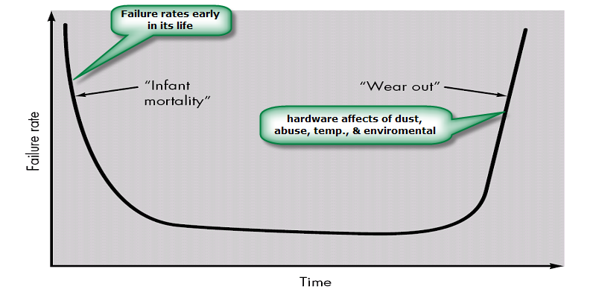
Failure curve for Hardware

Slide 9
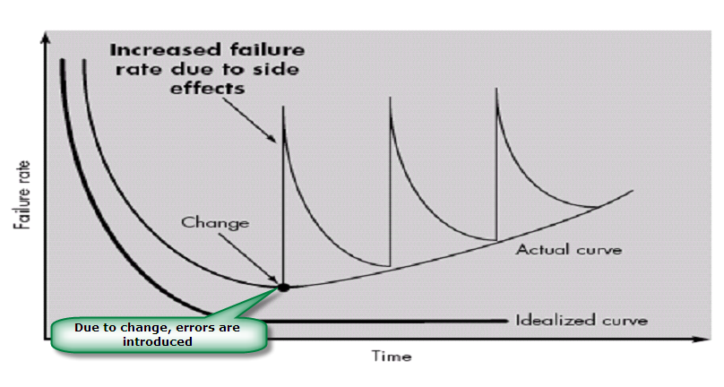
Failure curve for Software
When a hardware component wears out, it is replaced by a spare part.
There are no software spare parts. Every software failure indicates an error in design or in the process through which design was translated into machine executable code. Therefore, software maintenance involves considerably more complexity

Slide 10
Software characteristics
Software is developed or engineered; it is not manufactured.
Software does not “wear out” but it does deteriorate.
Software continues to be custom built, as industry is moving toward component based construction.

Slide 11
Changing nature of software
System software
Application software
Engineering/scientific software
Embedded software
Product line software
Web applications
Artificial intelligence software

Slide 12
Software Myths
Definition: Beliefs about software and the process used to build it. Myths have number of attributes that have made them insidious (i.e. dangerous).
Misleading Attitudes - caused serious problem for managers and technical people.
Management myths
Managers in most disciplines, are often under pressure to maintain budgets, keep schedules on time, and improve quality.
Myth1: We already have a book that's full of standards and procedures for building
software, won't that provide my people with everything they need to know?
Reality :
Are software practitioners aware of existence standards?
Does it reflect modern software engineering practice?
Is it complete? Is it streamlined to improve time to delivery while still maintaining a focus on quality?

Slide 13
Myth2: If we get behind schedule, we can add more programmers and catch up
Reality: Software development is not a mechanistic process like manufacturing. Adding people to a late software project makes it later.
People can be added but only in a planned and well-coordinated manner
Myth3: If I decide to outsource the software project to a third party, I can just relax and let that firm build it.
Reality: If an organization does not understand how to manage and control software projects internally, it will invariably struggle when it outsource software projects

Slide 14
Customer Myths
Customer may be a person from inside or outside the company that has requested software under contract.
Myth: A general statement of objectives is sufficient to begin writing programs— we can fill in the details later.
Reality: A poor up-front definition is the major cause of failed software efforts. A formal and detailed description of the information domain, function, behavior, performance, interfaces, design constraints, and validation criteria is essential. These characteristics can be determined only after thorough communication between customer and developer.
Myth: Project requirements continually change, but change can be easily accommodated because software is flexible.
Reality: Customer can review requirements and recommend modifications with relatively little impact on cost. When changes are requested during software design, the cost impact grows rapidly

Slide 15
Practitioner's myths
Myth1: Once we write the program and get it to work, our job is done.
Reality: Someone once said that "the sooner you begin 'writing code', the longer it'll take you to get done." Industry data indicate that between 60 and 80 percent of all effort expended on software will be expended after it is delivered to the customer for the first time.
Myth2: Until I get the program "running" I have no way of assessing its quality.
Reality: One of the most effective software quality assurance mechanisms can be applied from the inception of a project—the formal technical review.
Myth3: The only deliverable work product for a successful project is the working program.

Slide 16
Reality: A working program is only one part of a software configuration that includes many elements. Documentation provides a foundation for successful engineering and, more important, guidance for software support.
Myth4 : Software engineering will make us create voluminous and unnecessary documentation and will invariably slow us down.
Reality: Software engineering is not about creating documents. It is about creating
quality. Better quality leads to reduced rework. And reduced rework results in faster delivery times.

Slide 17
Legacy Software
Why must it change?
software must be adapted to meet the needs of new computing environments or technology.
software must be enhanced to implement new business requirements.
software must be extended to make it interoperable with other more modern systems or databases.
software must be re-architected to make it viable within a network environment.

